Slide 1
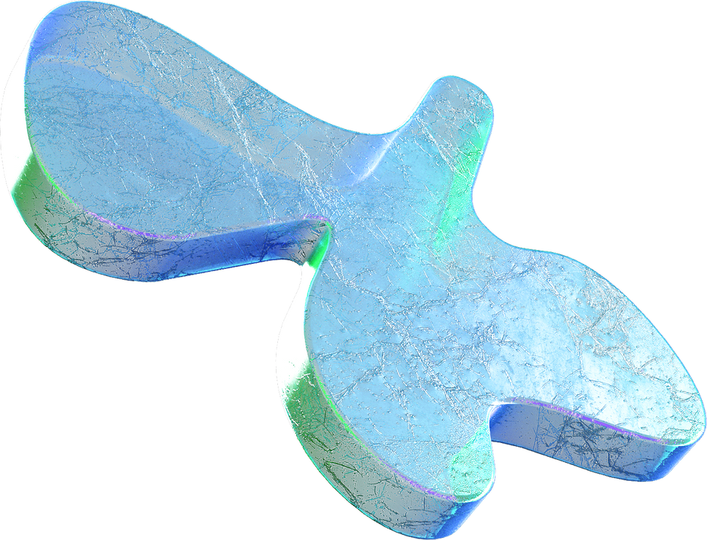
Deep Fake
Detection
Safeguarding Reality, Unmasking Illusions

Slide 2

Problem Statement
Develop a comprehensive Deep Fake and Audio Detection System to identify manipulated or synthetic media content, with a primary emphasis on videos. The system should leverage advanced techniques in computer vision and machine learning to distinguish between authentic and deep fake videos, as well as incorporate robust audio detection capabilities to identify potential manipulations in the audio components of the media content.

Slide 3
OBJECTIVE
Upload
Pre Process
Display Result
Predict

Slide 4
Generative Adversarial Network(GAN)
A Generative Adversarial Network (GAN) is a type of neural network architecture introduced by Ian Goodfellow and his colleagues in 2014. GANs consist of two networks, a generator, and a discriminator, which are trained simultaneously through adversarial training. The generator generates new data samples, and the discriminator evaluates whether these samples are real or fake. The adversarial process continues until the generator produces realistic samples that are difficult for the discriminator to distinguish from real ones.

Slide 5
InceptionV3
MobileNetV2
Uses a combination of 1x1, 3x3, and 5x5 convolutions to capture features at different scales.
Typically has a larger model size and requires more computational resources due to its complex architecture
It is specifically designed for mobile and edge devices with limited computational resources.
Is designed to be lightweight and computationally efficient, making it suitable for deployment on resource-constrained devices.

Slide 6

Is InceptionV3 better than MobileNetV2?
How InceptionV3 is different from MobileNetV2
InceptionV3 is a larger model optimized for high accuracy, while MobileNetV2 is a lightweight model designed for efficient deployment on resource-constrained devices.

Slide 7
Our Innovation in this Model
MultiModal Approach
Model Integration
Open Source Contribution
Model Training

Slide 8
Readiness for Implementation
Model Integration
Web Interface
File Handling
Video Processing
Audio Processing

Slide 9
Feasibility
Model Integration
Web Interface
File Handling
Video Processing
Audio Processing

Slide 10
Future Goals of Our Model
Deepfake detection will become crucial as the prevalence of synthetic media rises.
Advancements in Artificial Intelligence and Machine Learning will be harnessed for more robust deepfake detection techniques.
Intelligent Automation will play a key role in streamlining and enhancing deepfake detection processes.
Edge Computing solutions will gain prominence for real-time analysis in decentralized environments to combat deepfake threats.
Edge Computing will also gain more interest as businesses adjust to new ways of operating
Implementing DevOps practices will be essential for integrating and optimizing diverse technologies in the pursuit of effective deepfake detection.

Slide 11
Thank You!

